Slide 1

Subject: Python for Computational Problem Solving (PCPS)
Subject Code: UE23CS151A
MiniProject
SEMESTER - I
“SNAKE GAME”
Team details:
Gourav Kumar D - PES1UG23CS203
Nirav N Bosmiya - PES1UG23AM193
Akshay Sankarshana - PES1UG23ME008
Ashish Nayak - PES1UG23ME011
Under the guidance of,
Prof. Sowmya Shree P
Asst. Prof.
Dept. of CSE PES University

Slide 2










Python mInI Project
SNAKE GAME

Slide 3

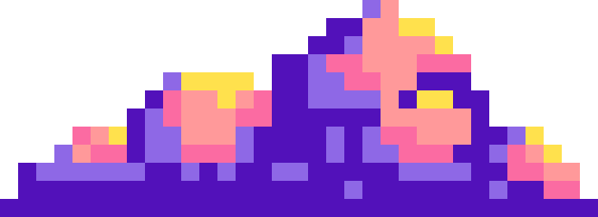


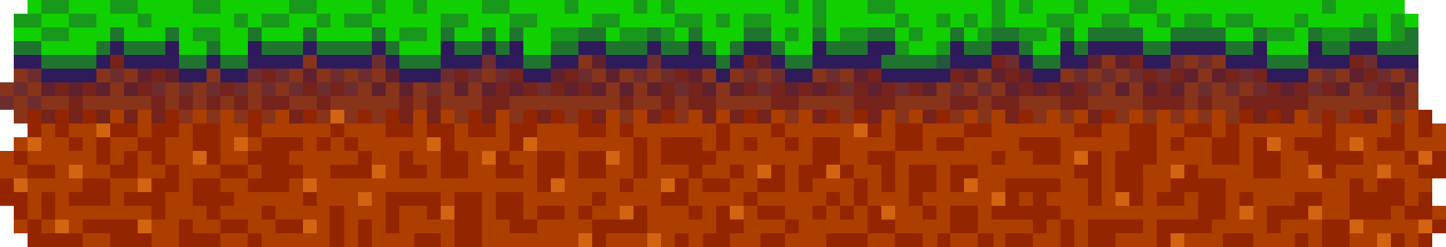
group members
NIRAV N BOSMIYA
PES1UG23AM193
Game logic
Gourav kumar PES1UG23CS203 Game logic
01.
02.
03.
Akshay s PES1UG23me008
Gui, Presentation
Ashish nayak
PES1UG23me011 gui, Presentation

Slide 4


problem statement
To Design a fun game in python where the player feeds a snake by moving it around the screen. THE objective of the player is to keep the snake on the screen and not tangle it, which leads to a “game over”.

Slide 5
INTRODuctIon
The snake game is a well-known game where one must feed a snake as it moves about the screen under the user’s control. A string of boxes represents the snake that needs to “eat” a round food element that causes it to grow and increase the user’s score. As it gets longer and longer, the snake is harder to maneuver. If the snake accidentally goes off the screen, or the player manages to tangle the snake, the snake dies and causes a “game over”.

Slide 6




modules of the game
TKINTER - Inbuilt module for GUI
RANDOM - Inbuilt module for Score Placement
Food – user-defined module for making score adding material
Snake – user-defined module for main object

Slide 7
IMPLEMENTATION: MOVEMENT
window.bind(”arrow key”, lambda event: change_direction(‘arrow direction’))
Checking of direction
if new_direction == ‘new arrow direction ':
if direction != ‘arrow direction ':
direction = new_direction
Movement
x, y = snake.coordinates[0]
if direction == ‘direction’:
x/y +-= SPACE_SIZE

Slide 8
IMPLEMENTATION: SCORE
x == food.coordinates[0] and y == food.coordinates[1]:
global score
score += 1 [updates score when the snake coordinates are aligned with food coordinates]
label.config(text="Points:{}".format(score))[changes score text on top of the screen]
canvas.delete("food") [removes food ]
food = Food(canvas, WIDTH, HEIGHT, SPACE_SIZE)[uses food module to assign a new food with new coordinates]

Slide 9
IMPLEMENTATION: FOOD module
User-defined Module that implements the visuals and location of food in the game.
It uses TKInter and RANDOM to code the module and implement it in the program externally.

Slide 10
IMPLEMENTATION: snake module
User-defined Module that implements the visuals, the movement, the location of the snake in the game.
It uses TKInter to code the module and implement it in the program externally.

Slide 11
IMPLEMENTATION: snake module
User-defined Module that implements the visuals, the movement, the location of the snake in the game.
It uses TKInter to code the module and implement it in the program externally.

Slide 12
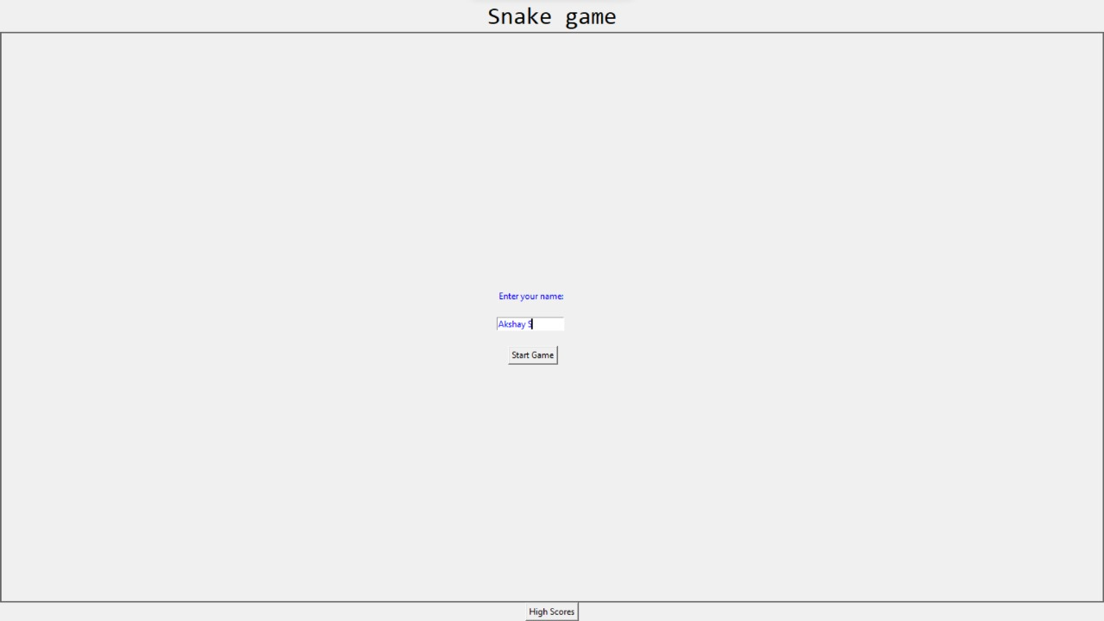
result
LOGIN:

Slide 13
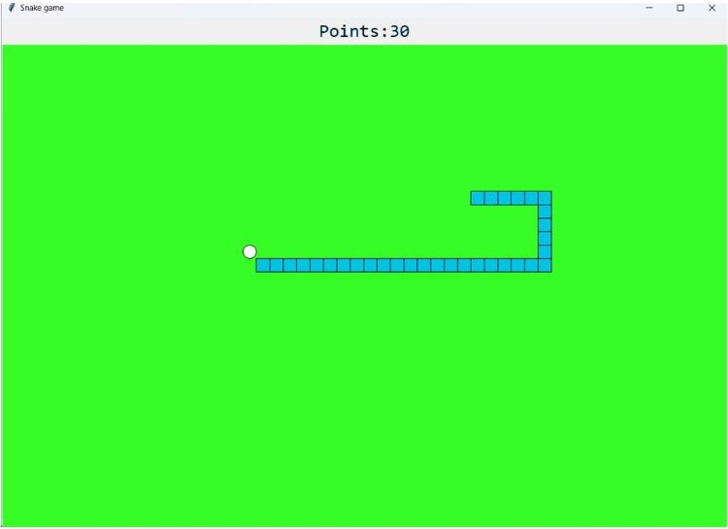
result
Running:

Slide 14
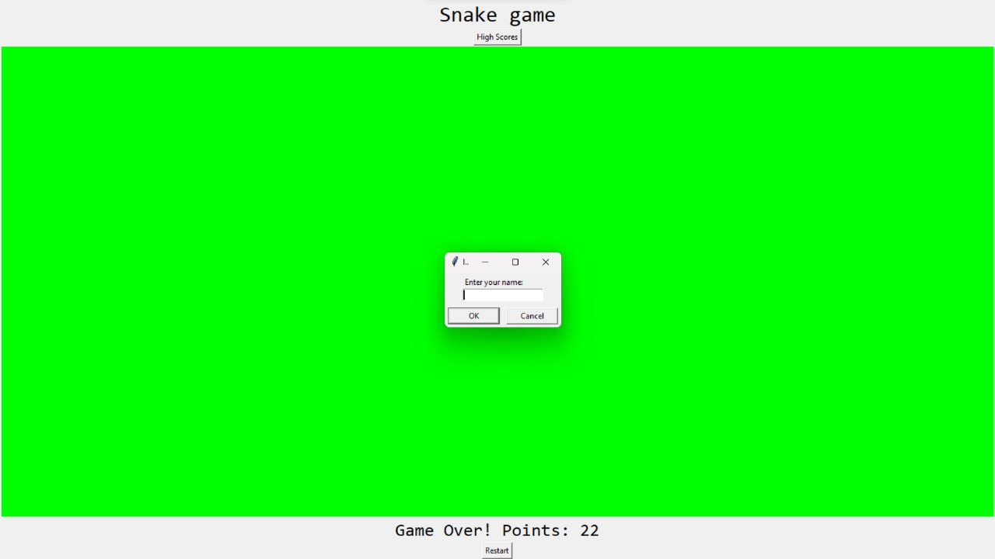
result
Game over:

Slide 15
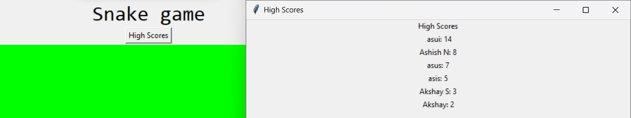
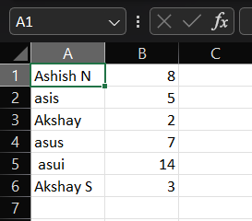
result
High scores leaderboard:

Slide 16
learnIng from project
While making this project, we learnt:
→to make custom modules
→to make the gui part of this game, from scratch
→interactive gameplay that responds to user input.
→to use functions & classes to optimize the code and simplify the programming overall.
03.

Slide 17
conclusIon
The snake game offers a challenging game to keep you entertained.
The benefits of videogames include improved powers of concentration, creativity, synapse. Videogames can make it entertaining while the player also develops chronometric skills.

Slide 18
Future work
Implement Multiple levels with higher difficulty.
Implement limited no. of lives.
Storing highest score for each level.
Create obstructions (walls) that the snake can’t move through.
Make the game multiplayer and online.
Make an online leaderboard for highest scores.

Slide 19


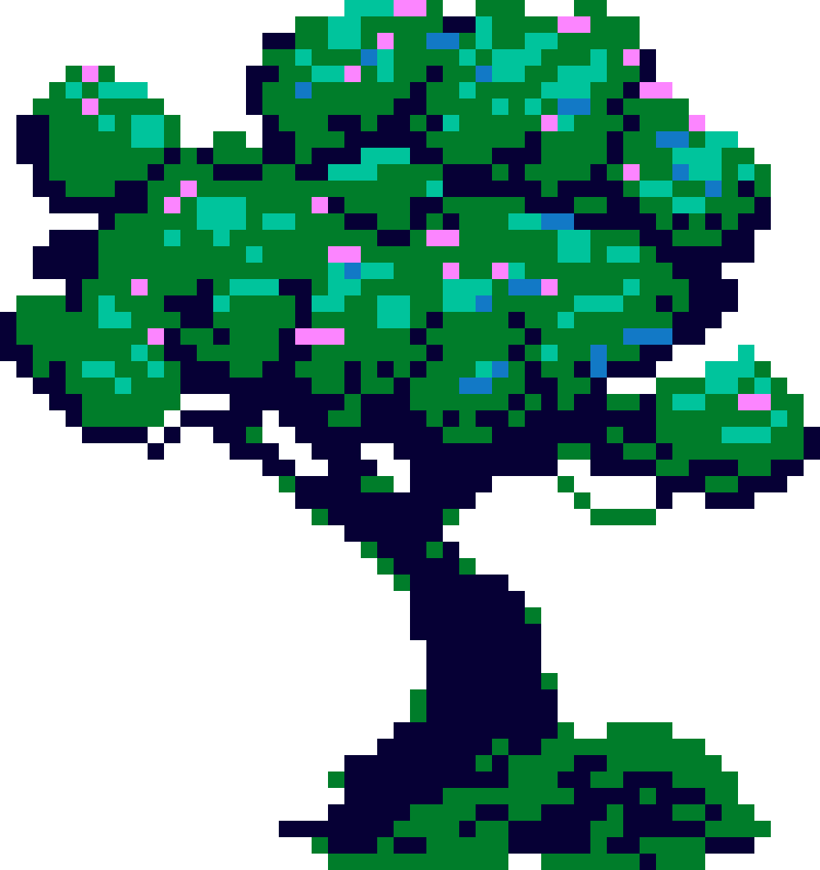
references
[1] https://www.w3schools.com/python/
[2] https://www.geeksforgeeks.org/python-programming-language/

Slide 20


thank you!

